Slide 1
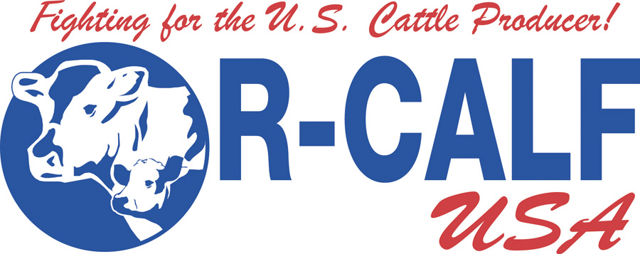
Why America Is Losing Its Ranches
Impacts of Lax Antitrust Enforcement
Bill Bullard, CEO
October 5, 2018

Slide 2
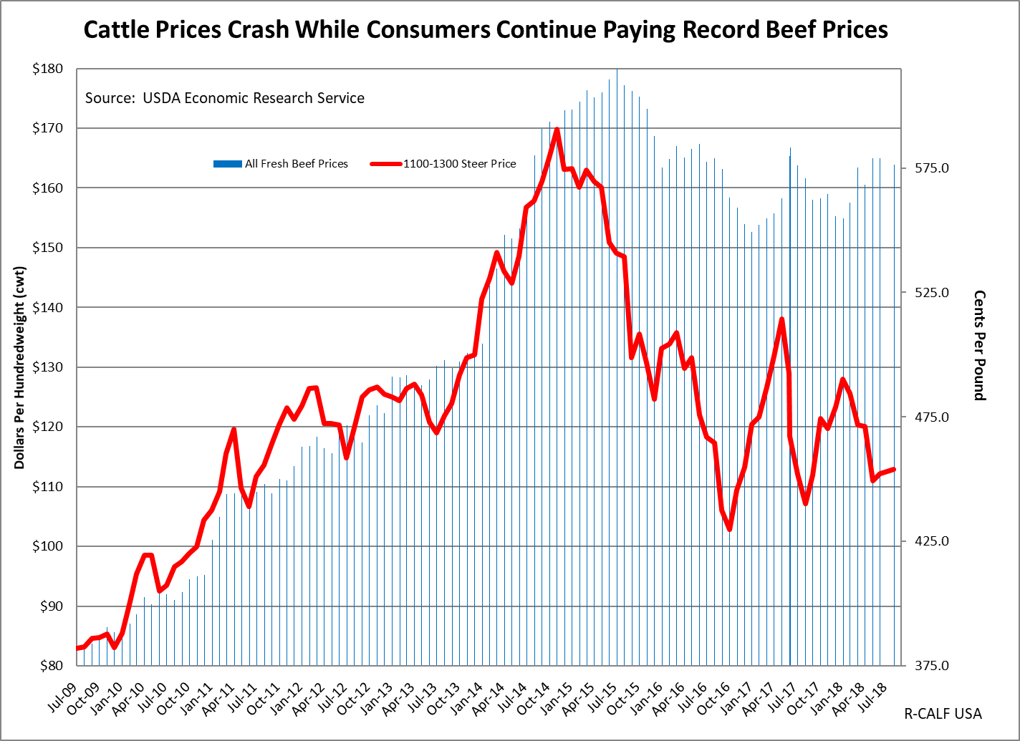
Notes:
Todays prices are where they were 7 and 8 years ago.

Slide 3
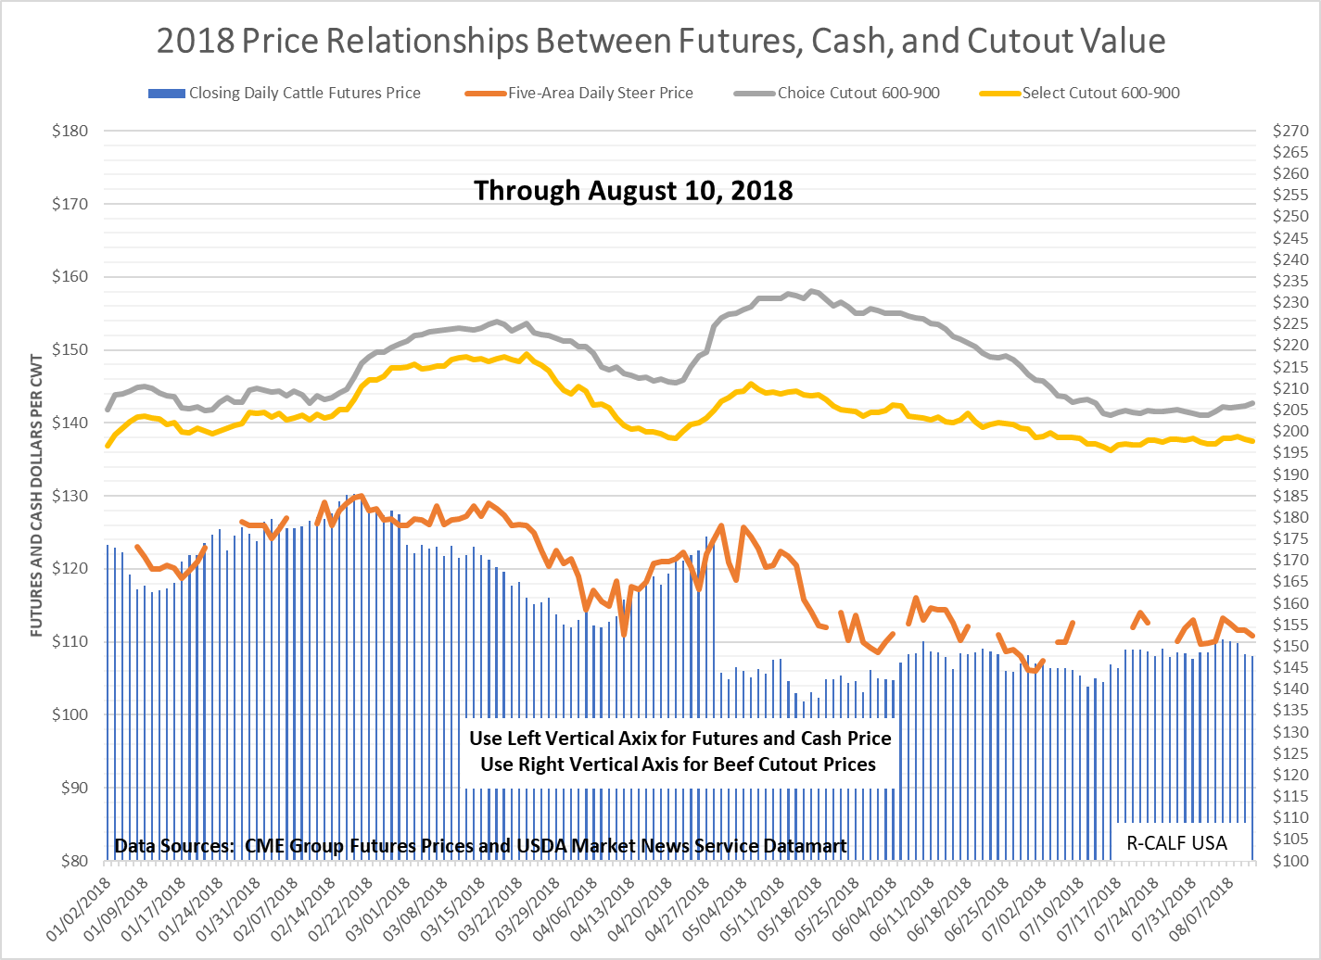
Notes:
April Contract went off at about $124. June closed at about $106, an $18 per cwt reduction.

Slide 4
Record Packer Margins

Slide 5
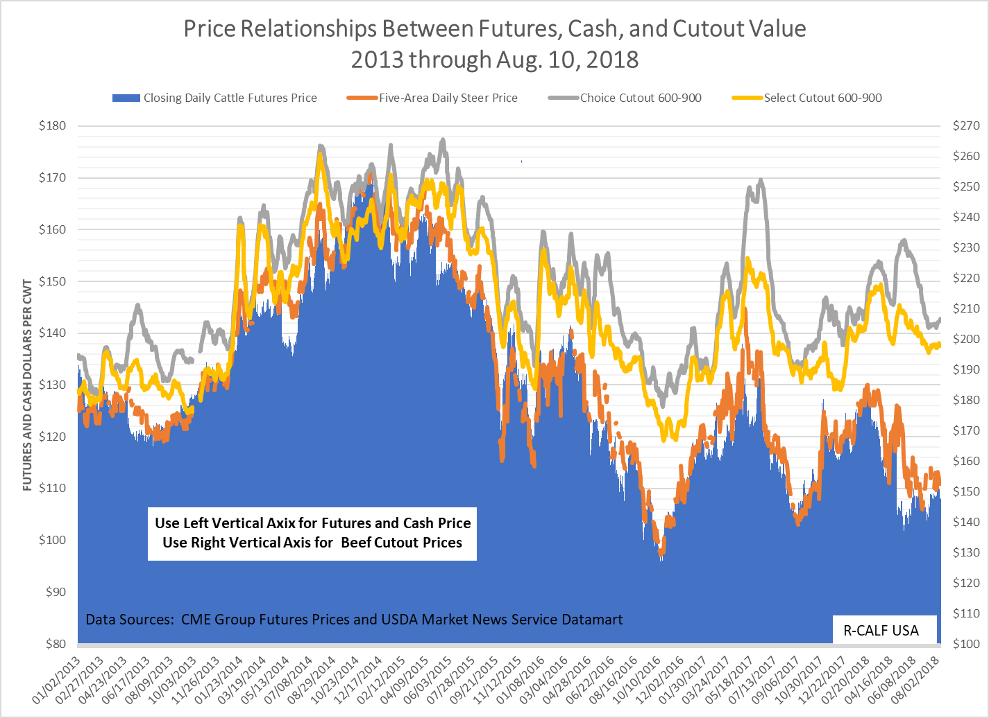

Slide 6
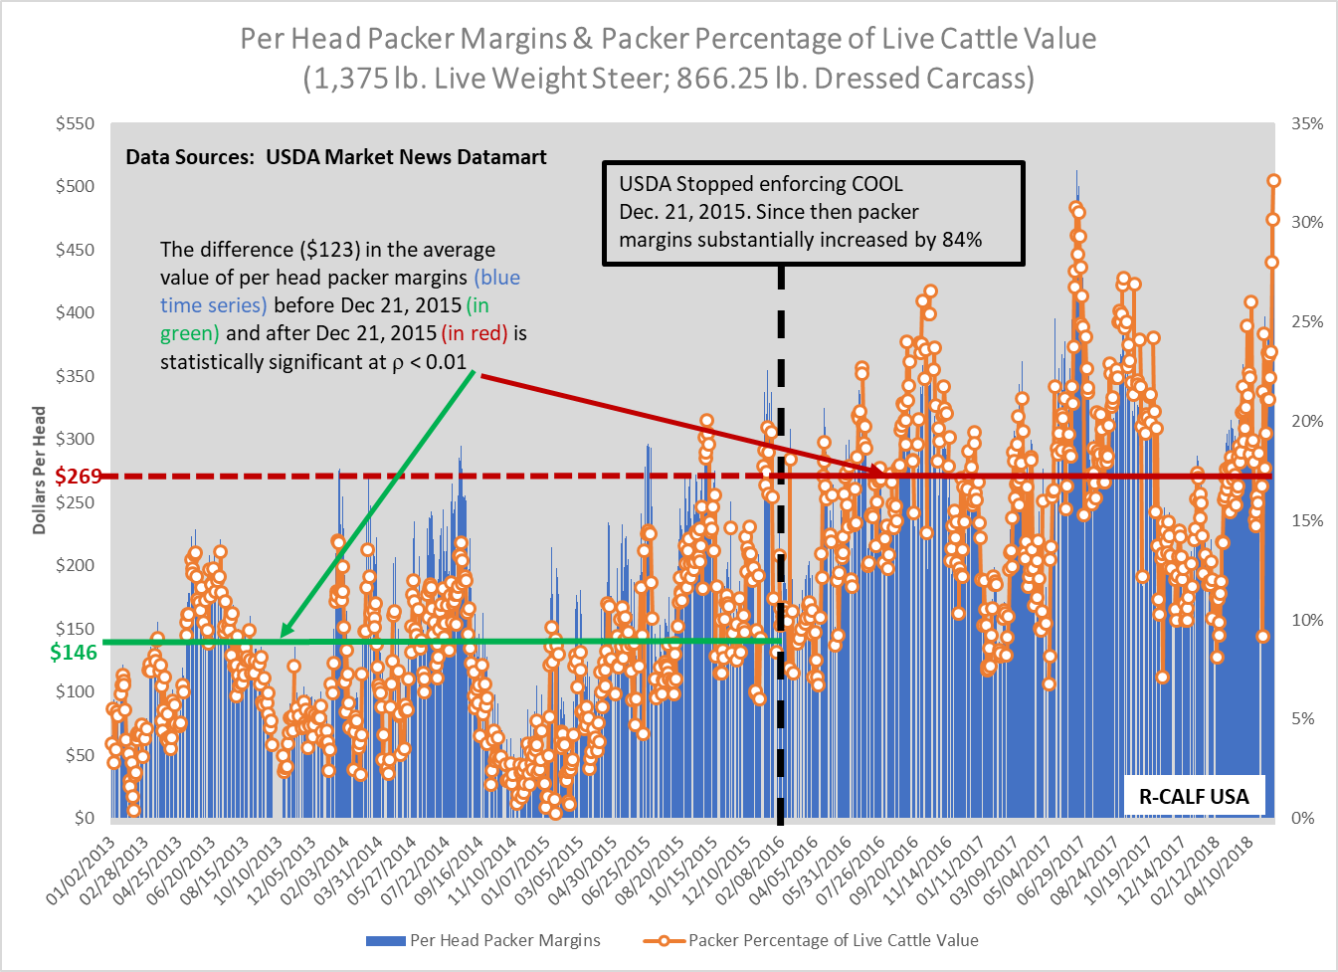
Notes:
Packer margins increased an average of $163 per head after COOL repeal. ρ < 0.01 means that at the 99 percent confidence level the difference in the average value of the Per Head Packer Margins is not random or did not occur by chance, but is attributable to a specific cause. In this case the USDA stopping enforcement of COOL.

Slide 7
State of the U.S. Cattle Industry

Slide 8
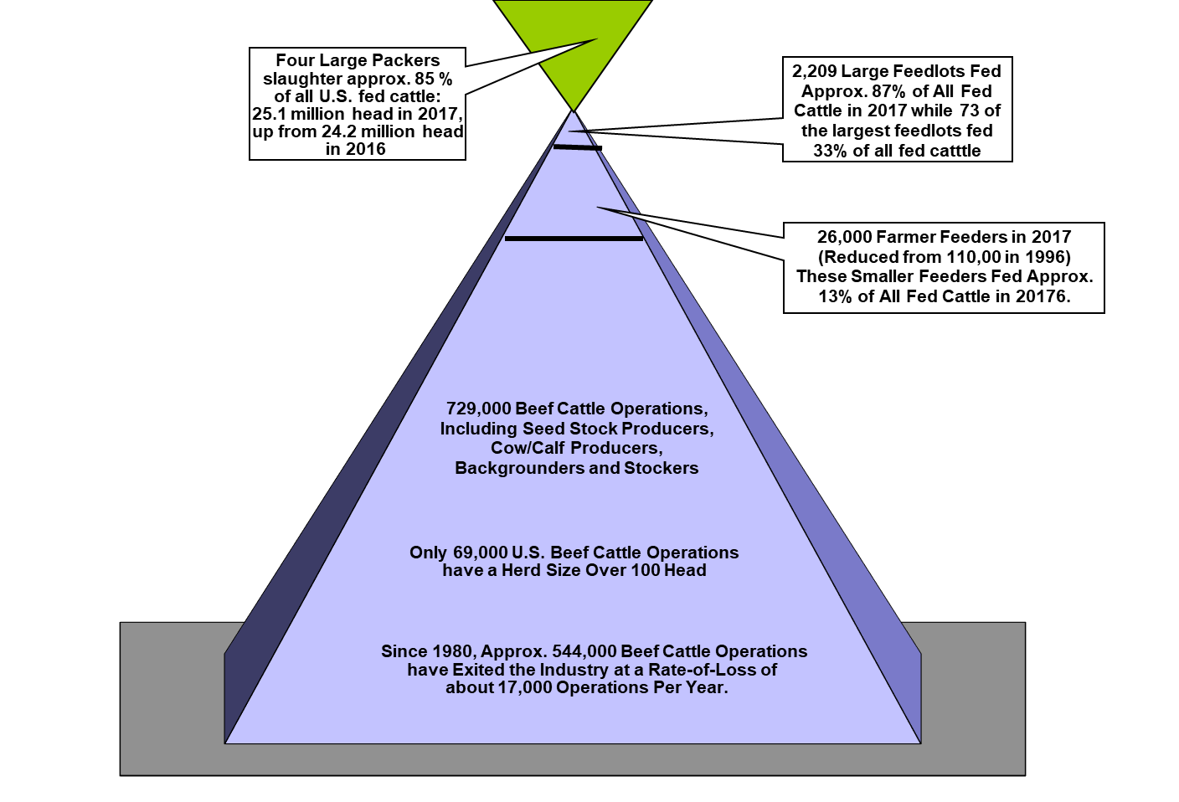
Today’s U.S. Cattle Industry

Slide 9
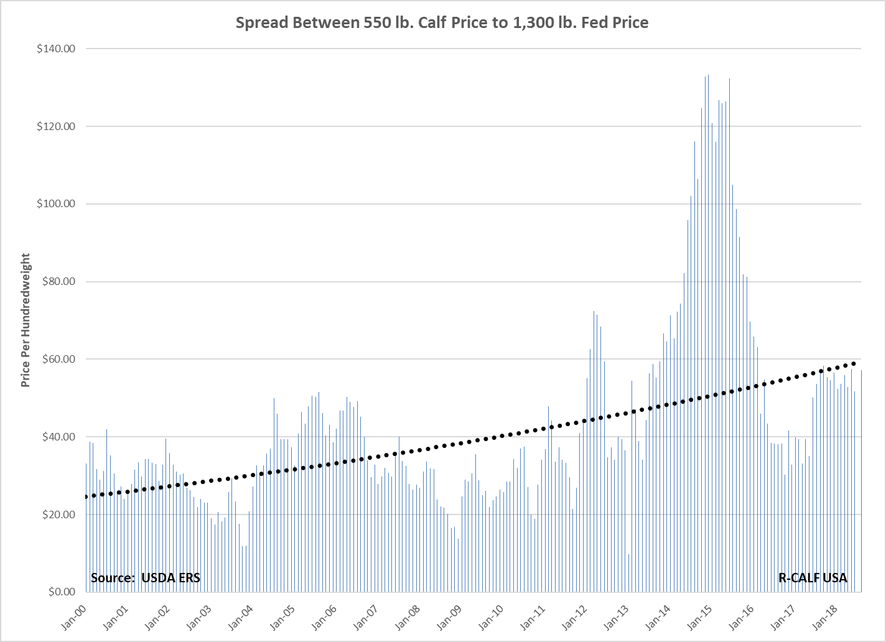
Notes:
Feedlots are paying a higher than competitive price for lighter weight calves for feeding. But finished cattle prices remain depressed. This is uneconomical for feeders who do not have sweetheart deals with the packers, forcing an exodus of smaller feeders.

Slide 10
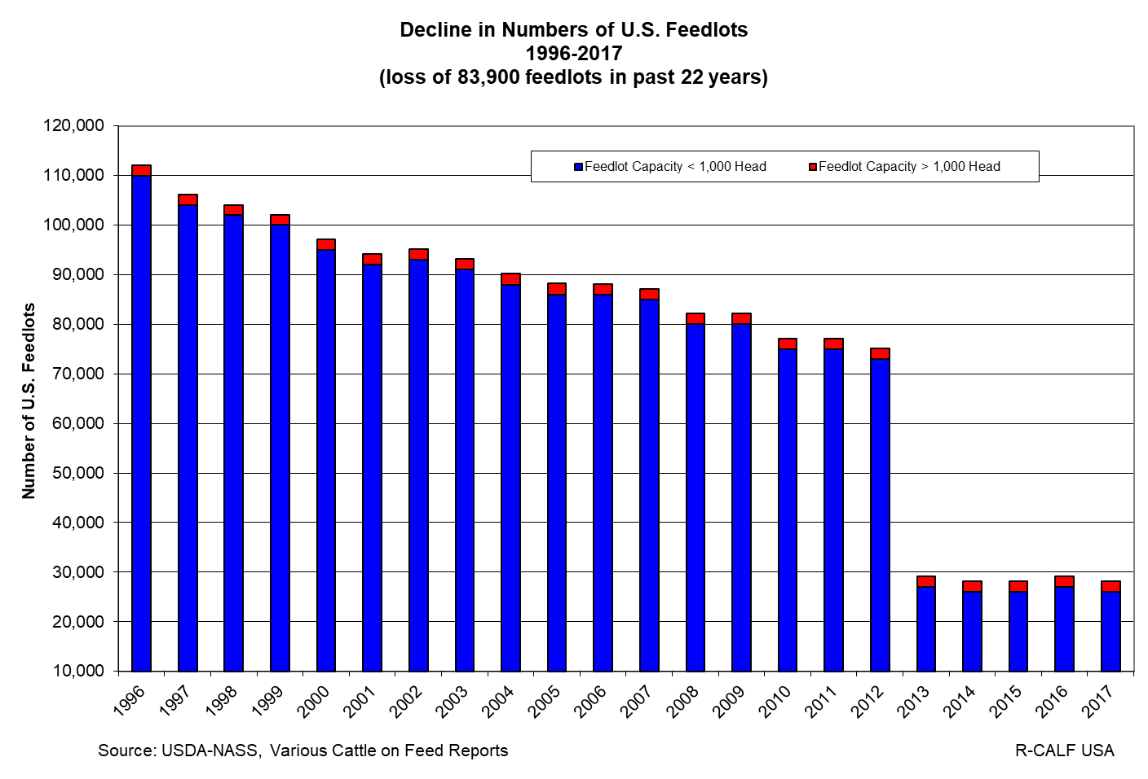
Notes:
Since NAFTA, 75 percent of all U.S. feedlot operations have disappeared, meaning there are nearly 84,000 fewer buyers to purchase the 25 million cattle that are raised each year by the 729,000 widely dispersed independent U.S. cattle farmers and ranchers.

Slide 11
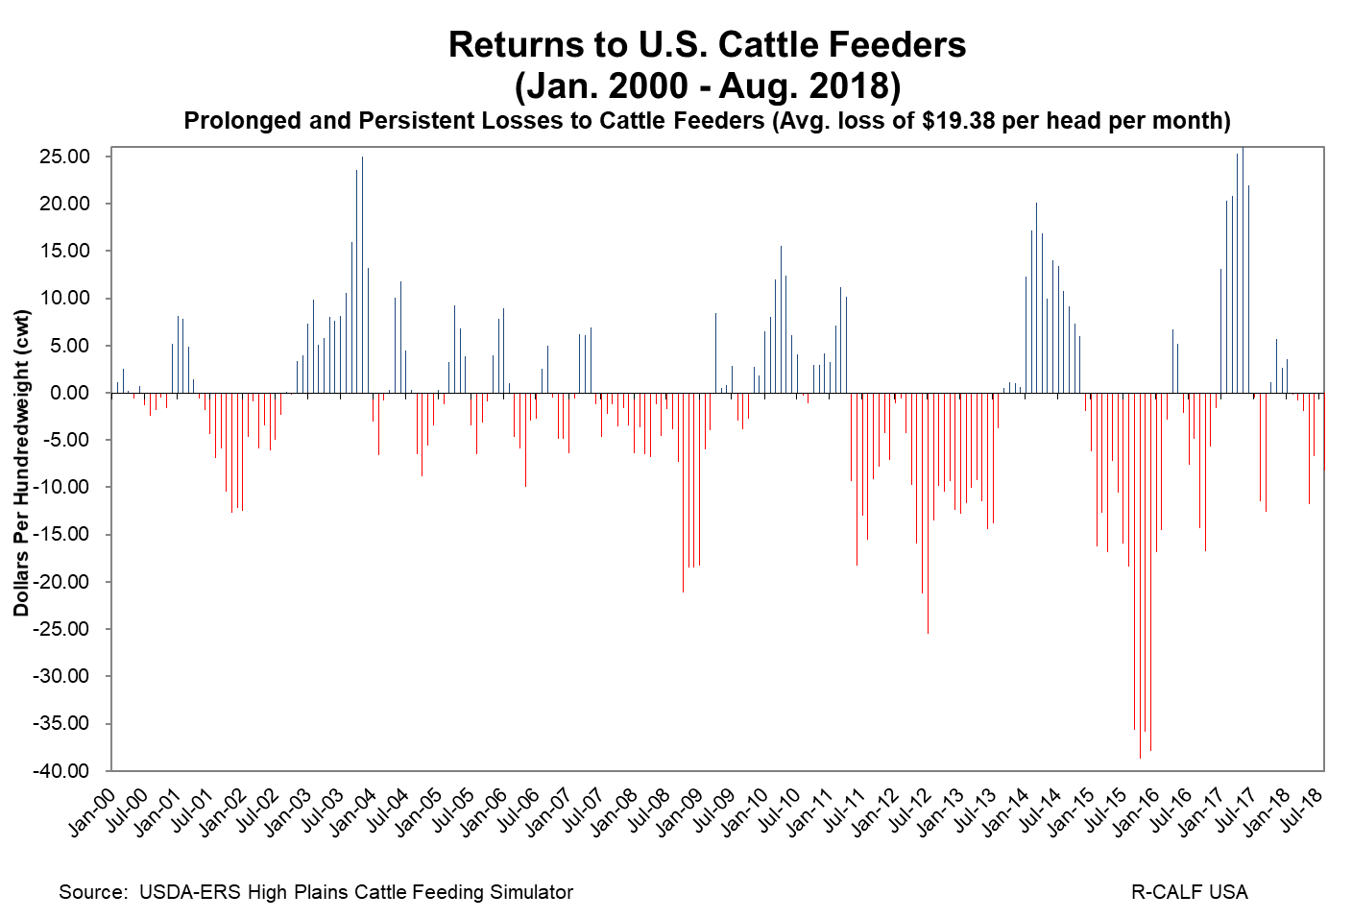
Notes:
USDA data explain why the U.S. has lost 75 percent of its feedlots. For 18 years, USDA data show the average return to cattle feeders in the U.S. was a negative $19.38 per head per month – for 18 years! It is amazing there are any feedlots remaining in the U.S.

Slide 12
Scenarios for Undue Preference or Advantage
In return for a feedlot’s commitment of all its cattle:
  packer promises to pay all costs plus $30 per head.
  packer offers a stop-loss contract, promising no losses greater than $30 per head.
  packer offers a $30 per head across-the-board payment not related to weight or quality.
  packer agrees to consistently pay more than the cash price, even when quality of cattle is significantly lower.
  packer sends feedlot a year-end bonus of $0.10 per pound for all cattle committed during the year.

Slide 13
Notes:
Why use a pricing component that packers are incentivized to drive downward?

Slide 15
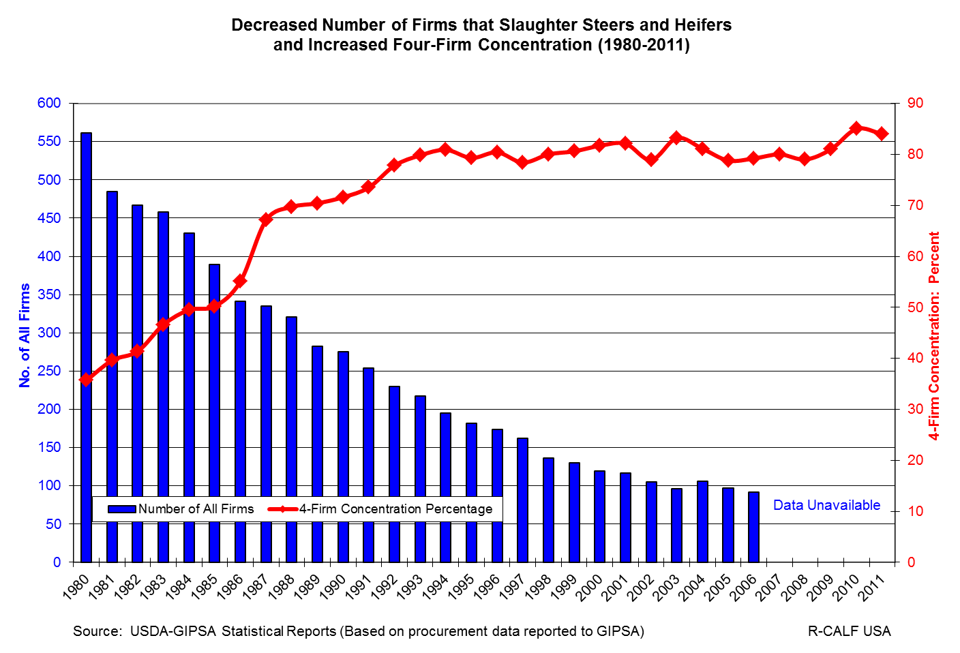

Slide 16
What’s At Risk Here?
Potential to lose competitive processes and competitive marketing channels (e.g., salebarns, farmer-feeders, order buyers, packer buyers).
We must begin to aggressively enforce antitrust laws before we reach the point where there is no longer any meaningful competition to preserve.

Slide 17
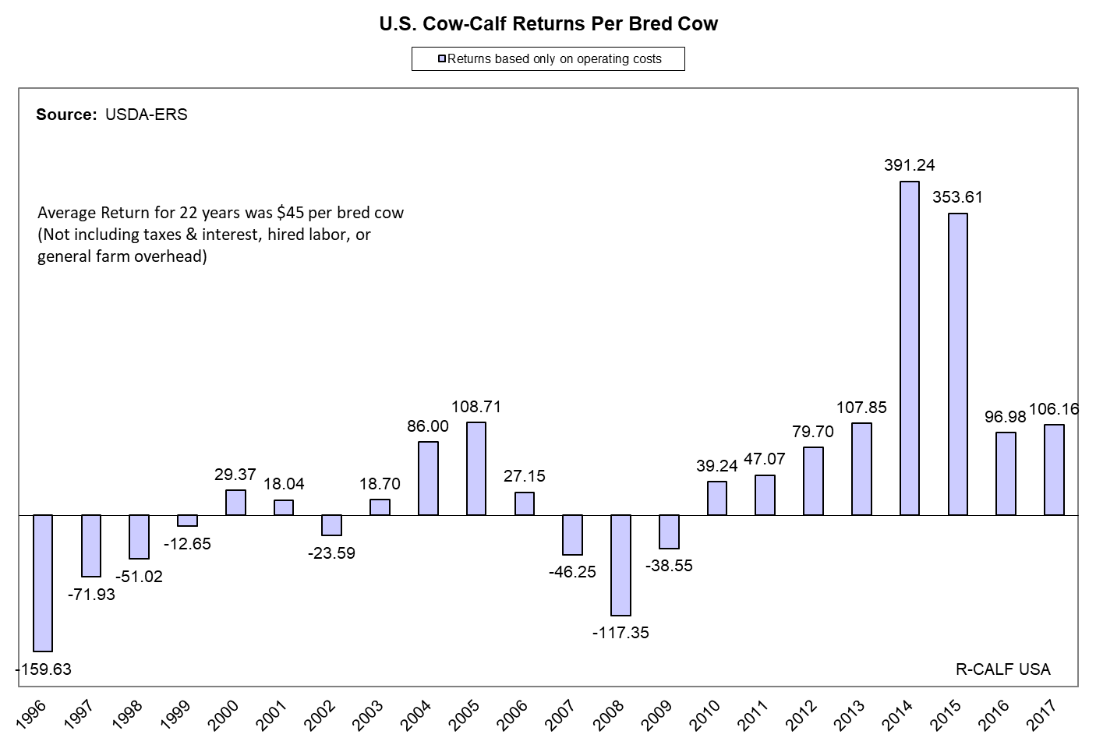
Notes:
Operating costs measure short-run profitability of a cow/calf enterprise. They do not include economic costs.
13 years prior to COOL implementation, returns averaged -$14.96
4 years during partial COOL implementation, returns averaged $31.87
3 years during full COOL implementation, returns averaged $284.23
2 years after COOL repeal, returns averaged $101.57
Average producer returns have fallen 64% since the repeal of COOL

Slide 18
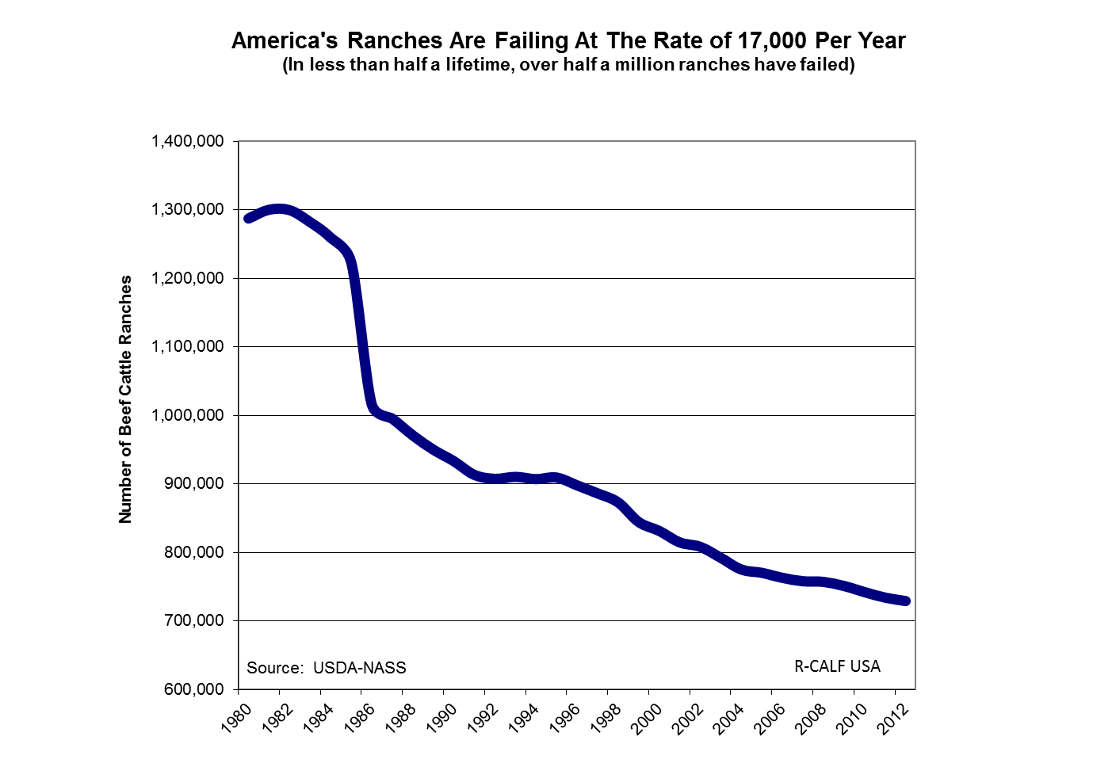
America’s Ranches Are Fast Disappearing
Notes:
The U.S. Department of Agriculture has not provided any new data regarding ranch numbers since 2012, so we probably have far fewer ranches today than we did five years ago in 2012..

Slide 19
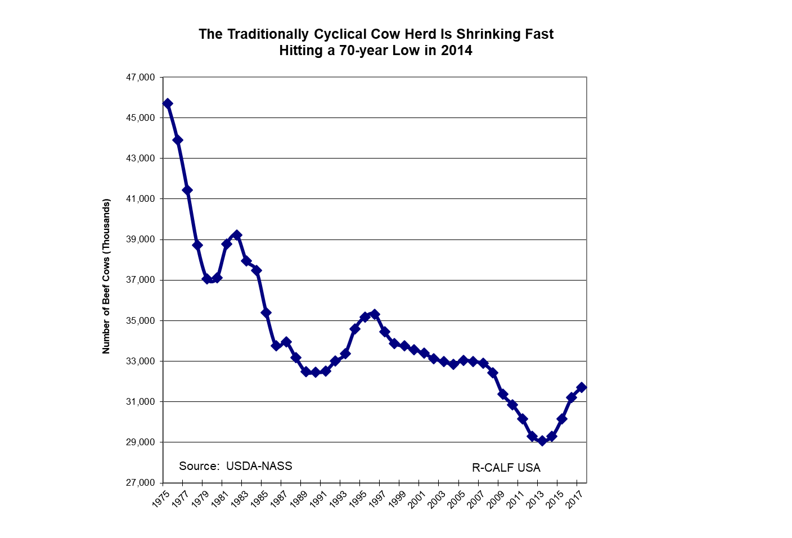
Notes:
As a result of the growing trade deficit and unfair trade practices (e.g., disallowing U.S. producers to distinguish their exclusively U.S. product in the marketplace), the U.S. cattle industry – the largest segment of American agriculture, is shrinking fast. Recently, in 2014-15, the U.S. mother cow herd fell to the lowest level in over 70 years, and well below pre-NAFTA levels.

Slide 20
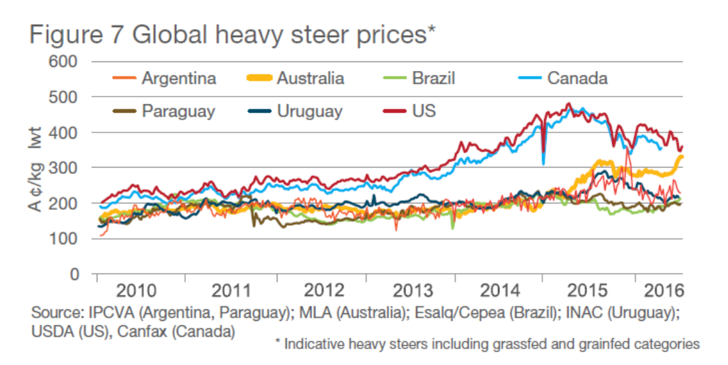
http://www.mla.com.au/prices-markets/Trends-analysis/cattle-projections/
Notes:
For comparison, whereas the sheep industry was decimated by imported carcasses that were $55 cheaper than domestic carcasses, the difference between prices for domestic live cattle and live cattle in countries from which beef and/or cattle is imported into the U.S. is much greater. As the chart above reveals, Canadian cattle are typically priced below domestic cattle, a practice that lowers the value of domestic cattle when those cheaper cattle are imported into the United States. For example, in 2016, heavy steers in Canada were priced about $60 per head cheaper than comparable domestic cattle, which contributed to the depressed prices that U.S. cattle producers received that year. The price difference between U.S. and Uruguayan and Brazilian cattle, for example, is much greater. In 2016, Brazilian cattle were priced more than $500 less per head than domestic cattle. Despite this significant price disparity between domestic and imported cattle; and, consequently, between domestic and imported beef, the corporate-aligned beef lobbyists oppose mandatory Country of Origin Labeling (COOL), which is necessary to enable domestic producers to compete against this growing tide of cheaper, though undifferentiated products imported from Canada, Mexico, and elsewhere.

Slide 21
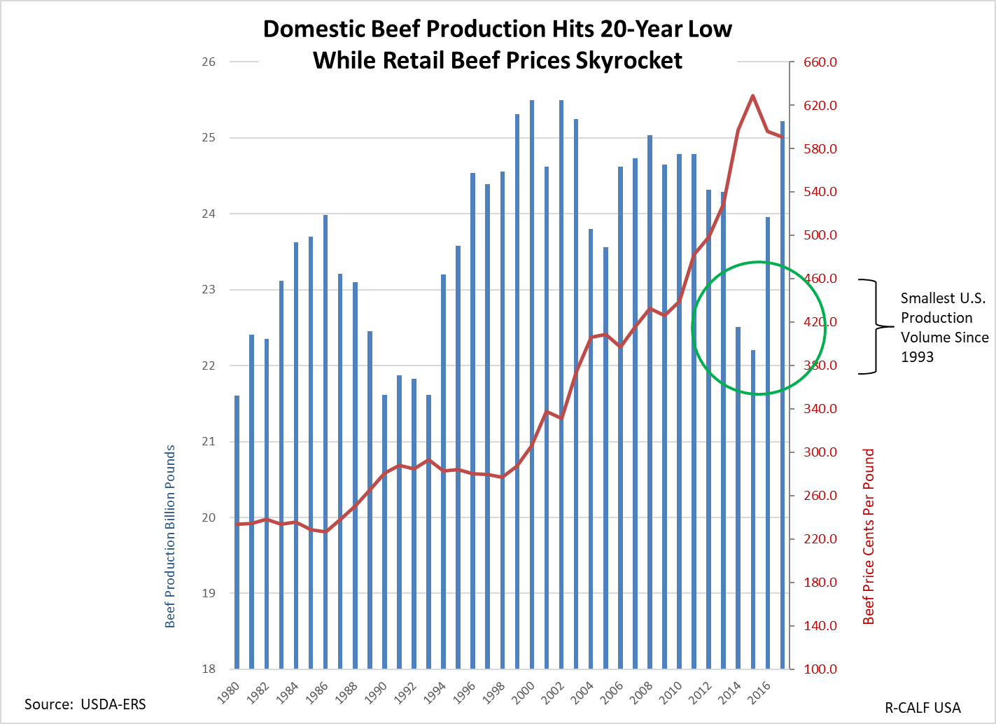
Notes:
In 2014 and 2015, the production of domestic beef fell to the lowest level in over two decades. Not since 1993, the year before NAFTA was implemented, had the U.S. produced such a small volume of beef. As indicated by this chart, consumer beef prices were driven to record highs during NAFTA.

Slide 22
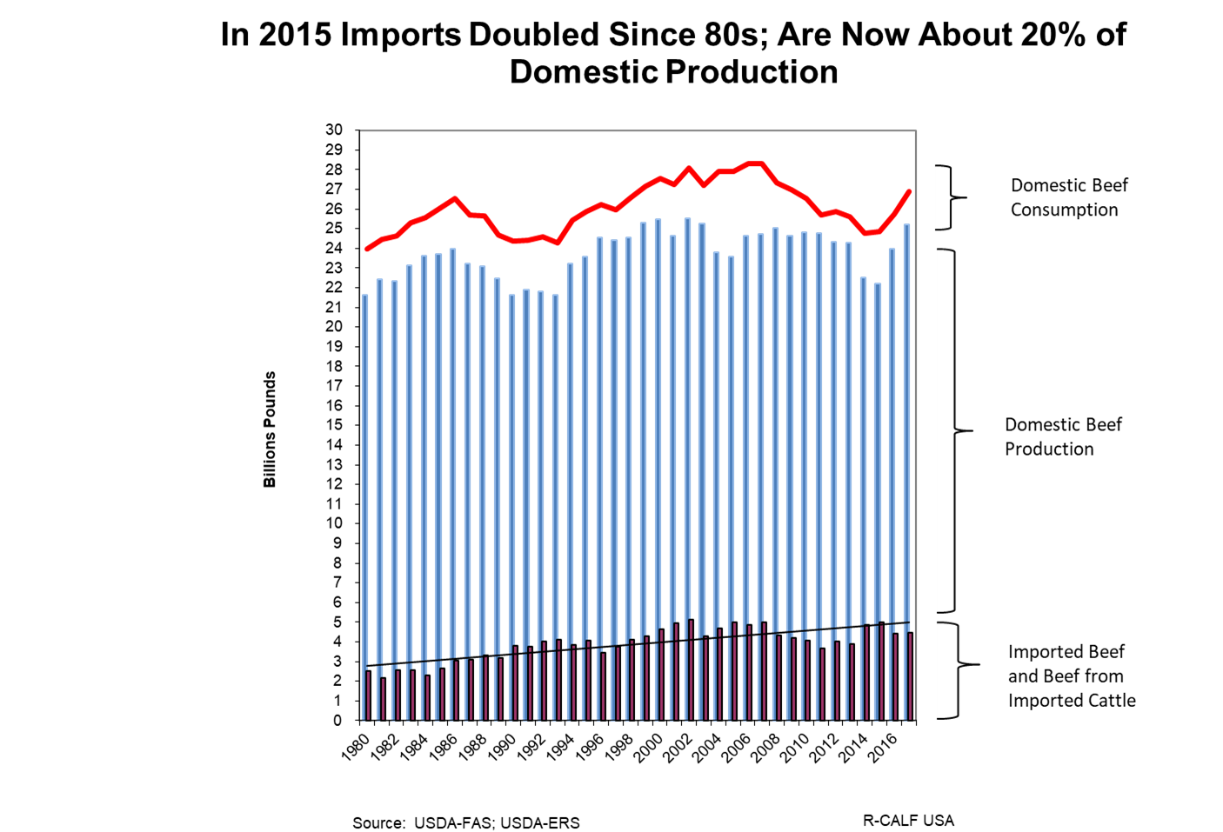
Notes:
This slide shows that the beef cartel is relying more and more on imported beef and cattle to satisfy domestic beef consumption. As revealed by the next slide, today’s cattle ranching industry is where the sheep ranching industry was in the early- to mid-90s. And now our sheep industry is decimated.

Slide 23
With the government’s blessing, the beef packing cartel uses undifferentiated imports along with its stranglehold over the market to drive down cattle prices, forcing the exodus of hundreds of thousands of American ranchers.

Slide 24
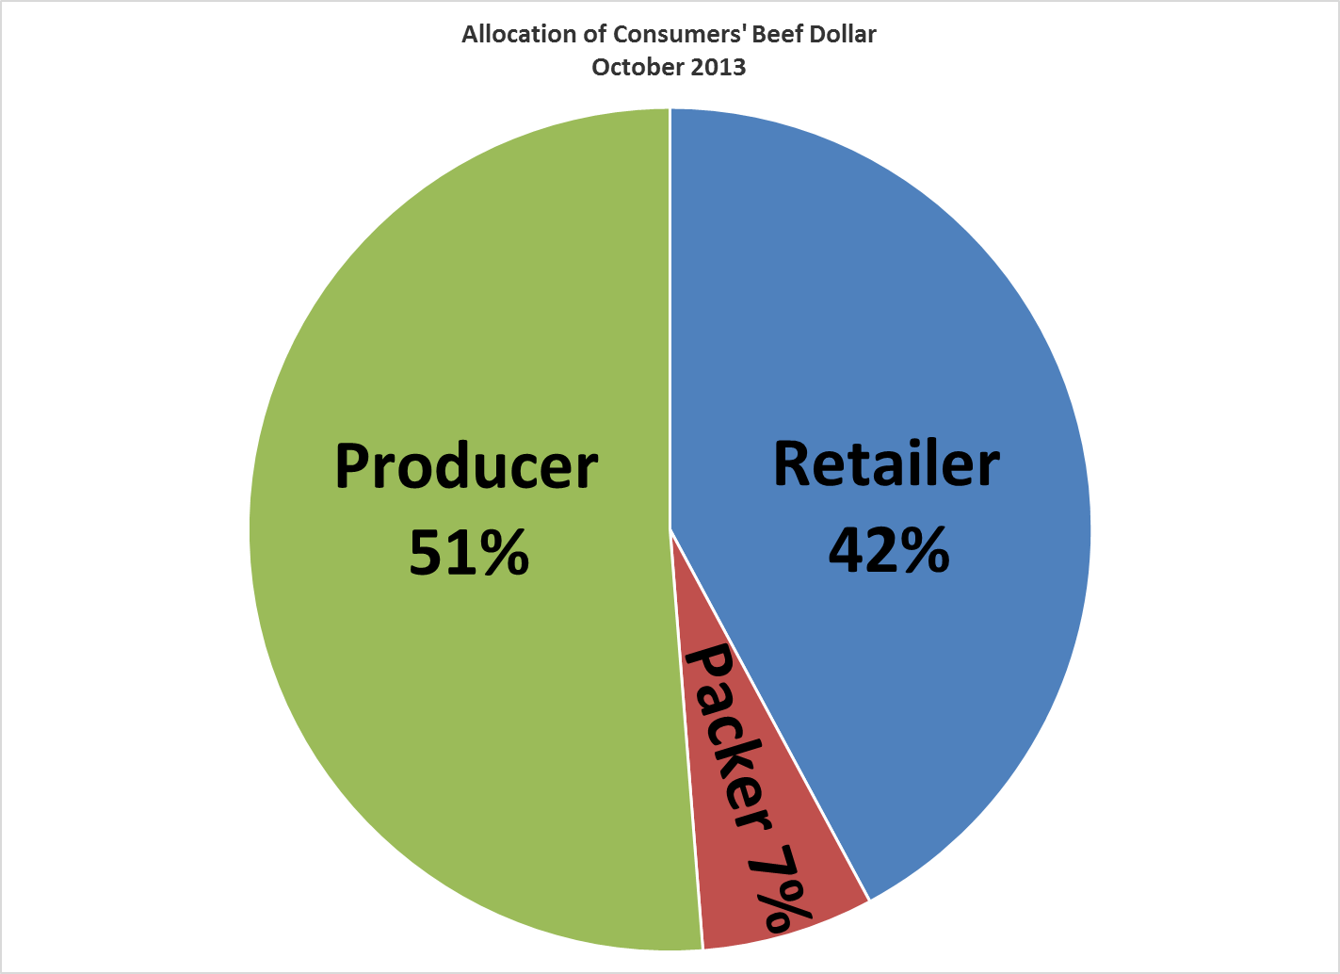
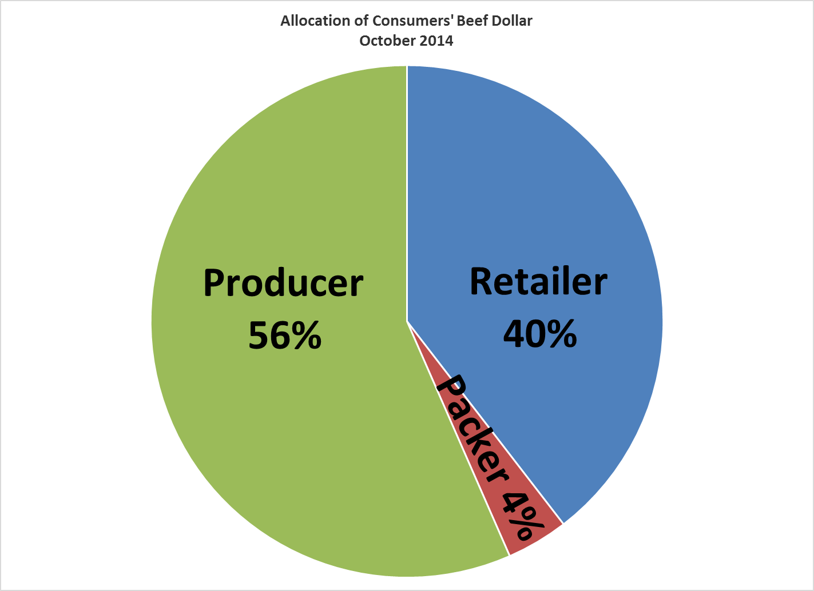
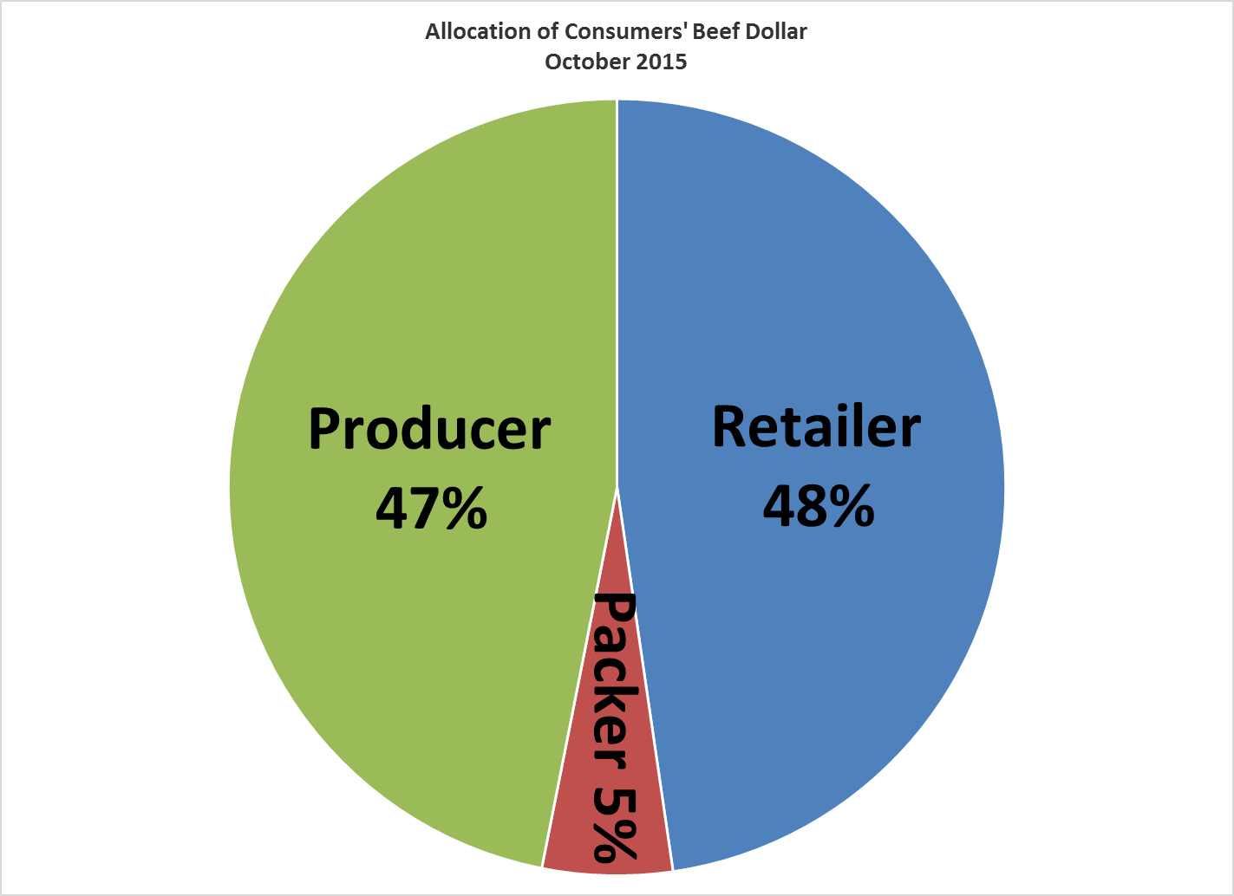
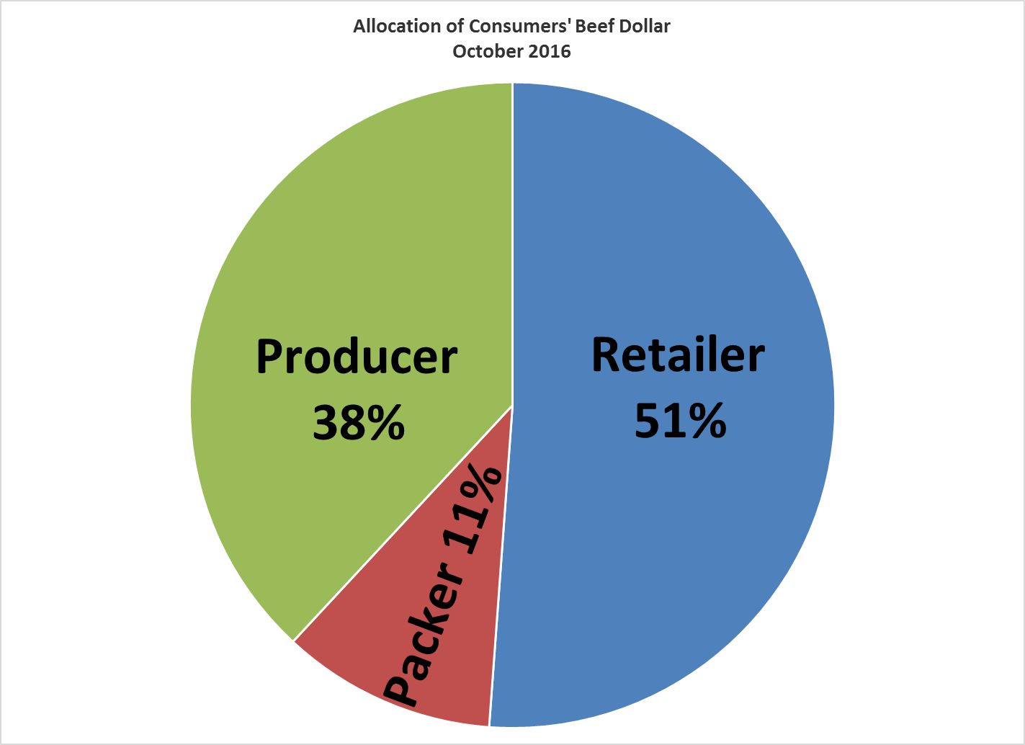
Notes:
When supplies tight, packers compete.
We suspect packers are colluding with retailers: reduce demand for beef, clear increased production of pork and poultry.
October 2017: Producer Share 43%, Retailer Share 47%, Packer Share 10%

Slide 25
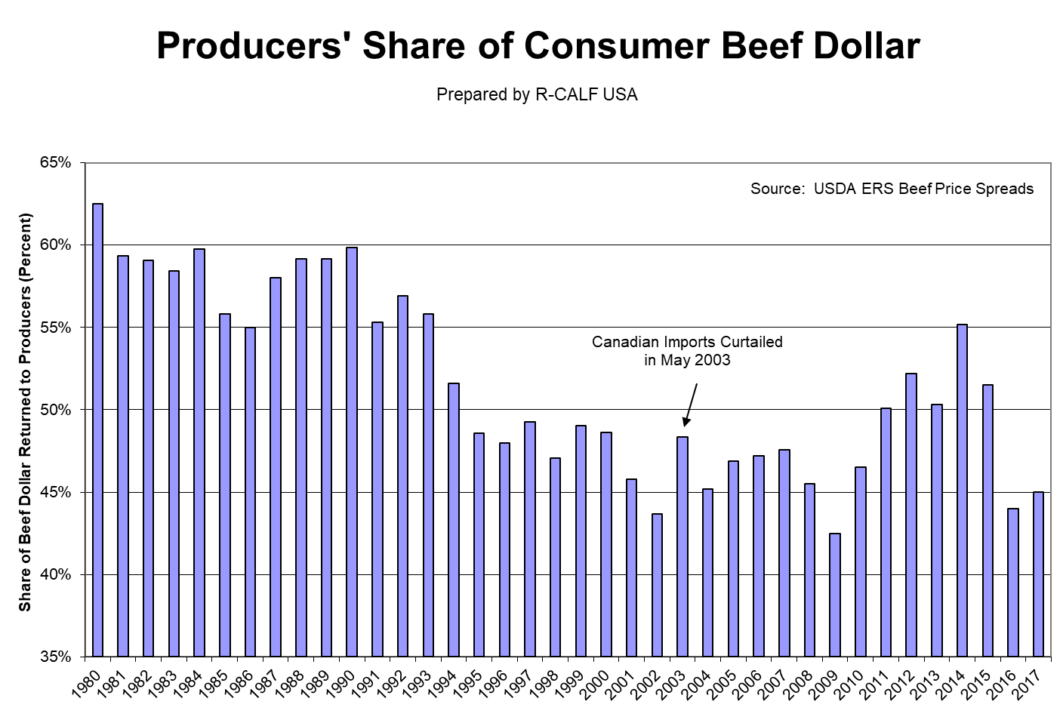

Slide 26
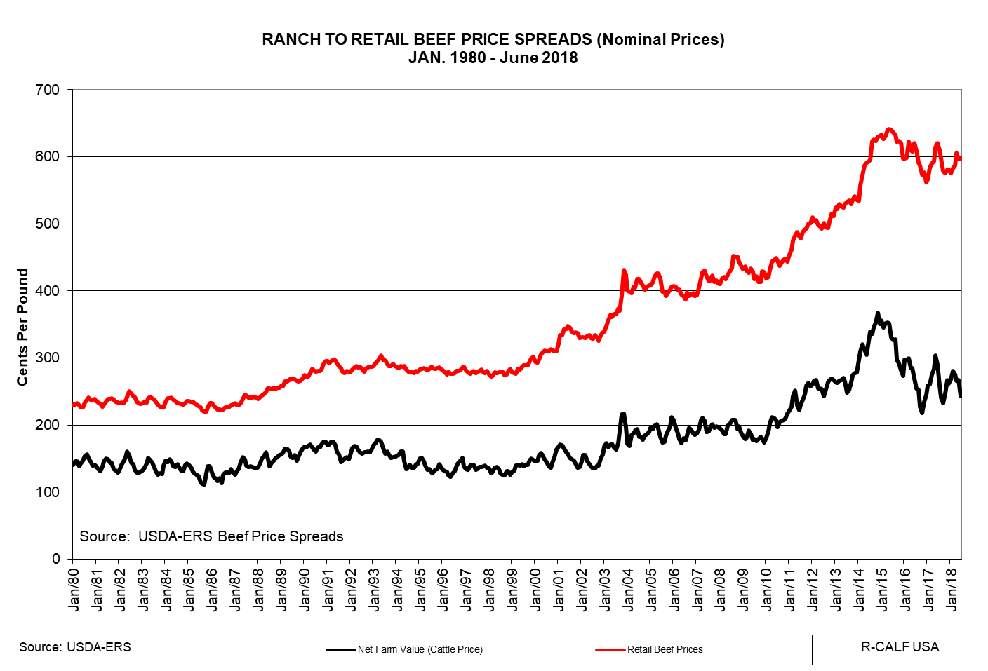

Slide 27
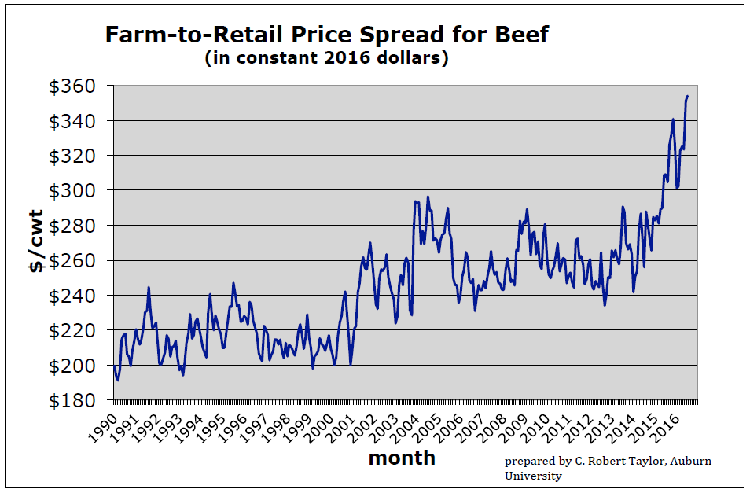
Exploitation of Producers & Consumers

Slide 28
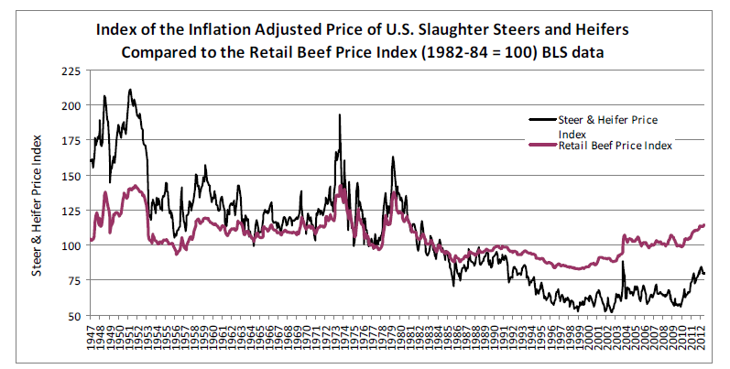

Slide 29
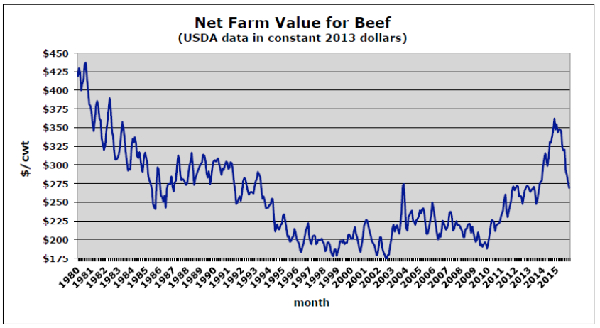
C. Robert Taylor Chart

Slide 30
Market Access Risk
Packer concentration has empowered packers to become market gatekeepers, where the many cattle sellers have too few cattle buyers.
18 weeks in which there was only one market participant, four weeks in which there were none . . . . So we consistently can see region by region where we had a presence where the region is dominated by one buyer, clear and simple.
- Bruce Cobb, CEO, Consolidated Beef Producers, 2010 -

Slide 31
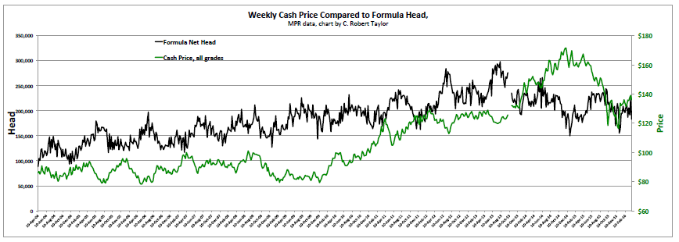
Notes:
2004-2016

Slide 32
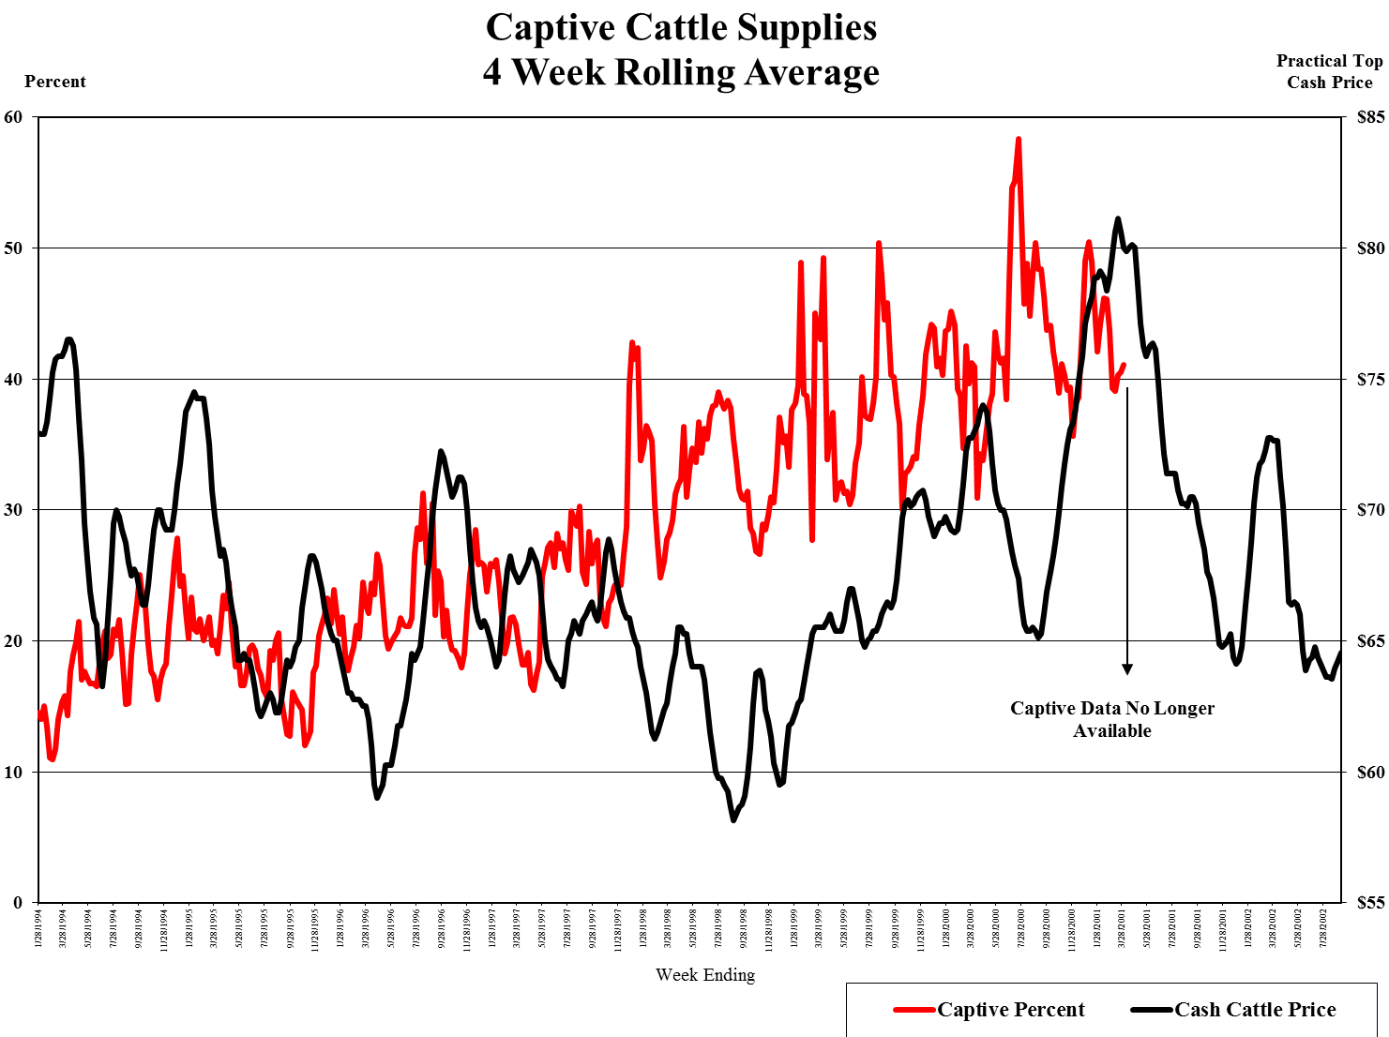

Slide 35
Including the Futures Market
Unprecedented limit moves in single year
Major disconnect between futures price and cash price
Market fundamentals do not explain the larger moves
Big orders attributed to big market moves were made manually, not electronically
Cattle futures market has become extremely thin where today a 200 lot market order can turn the cattle futures market on its head
CFTC investigation of 400 orders taken April 28, 2016

Slide 36
Captive Supply Study
Captive Supply Impact on the U.S. Fed Cattle Price: An Application of Nonparametric Analysis, Journal of Rural Development, 2011
  When captive supply reaches 20 percent of total cattle procurement, “[b]eyond this point, the U.S. fed cattle price decreases approximately $0.20/cwt ~ $0.40/cwt for each percent increase in the captive supply share.”
  2015 reduction: $10.90-$21.80 per cwt, or between $136.25 and $272.50 per head

Slide 37
Mergers and acquisitions are about gaining market power, not efficiency
Blonigen et al. 2016 (U of OR): "we find that M&As are associated with increases in average markups, but find little evidence for effects on plant level productivity. We also examine whether M&As increase efficiency through reallocation of production to more efficient plants or through reductions in administrative operations, but again find little evidence for these channels, on average."

Slide 38
Antitrust Enforcement
Stiegert et al., 2011: Packers switch between cooperating (colluding) and competing depending on whether short-term cattle supplies are tight (competition phase) or plentiful (cooperation/collusion phase). According to this study, the packers’ margins declined significantly when they had to compete and fed cattle prices were reduced 8-9 percent when they cooperated.
Notes:
2009 JBS accused of Bribery. Judge freezes some of JBS’ assets

Slide 39
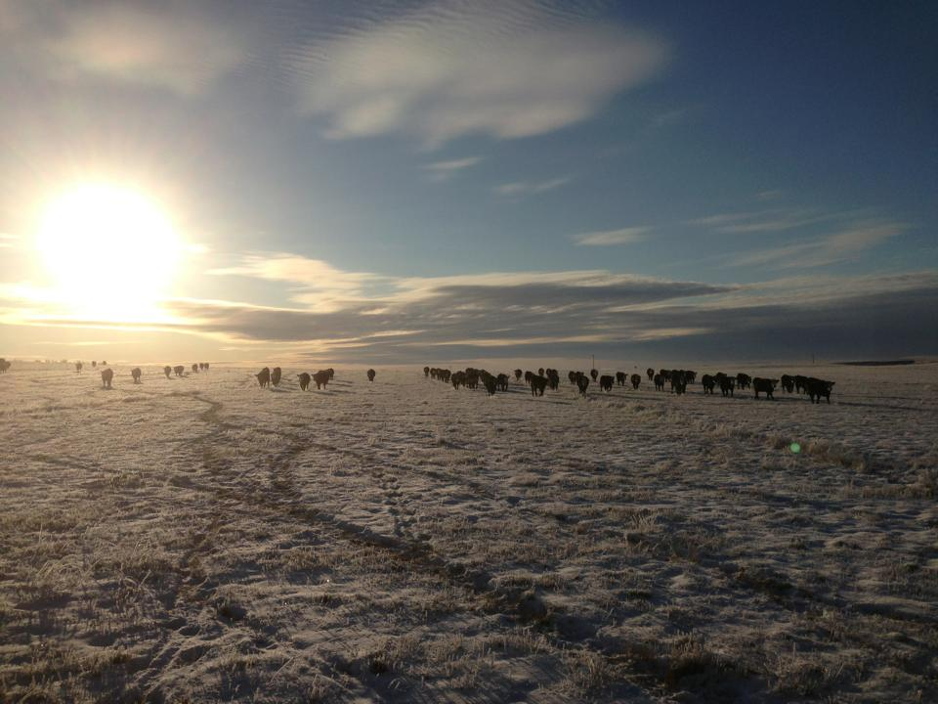
The End

